Slide 1


DISTRIBUTED APPLICATION INTEGRATION
january 2022
Presented by Mercenier Louis, Martinot Romain & Streignard Rémi

Slide 2

Plan
Architecture
Technologies
Gameplay
Buildings
Events
Interactions
Multiplayer

Slide 3











Front end
Back end
Game engine
1

Slide 4
Flutter is Google’s UI toolkit for building beautiful, natively compiled applications for mobile, web, desktop, and embedded devices from a single codebase.
https://flutter.dev/
2

Slide 5
A minimalistic Flutter game engine. Provide a complete set of out-of-the-way solutions for the common problems every game developed in Flutter will share.
https://flame-engine.org/
2D game engine made on top of Flame. Create RPG-style or similar games with Flutter.
https://bonfire-engine.github.io/
Bonfire
3

Slide 6
Tiled is a 2D level editor that helps you develop the content of your game.
Its primary feature is to edit tile maps of various forms, but it also supports free image placement as well as powerful ways to annotate your level with extra information used by the game.
https://www.mapeditor.org/
4

Slide 7
As an asynchronous event-driven JavaScript runtime, Node.js is designed to build scalable network applications.
https://nodejs.org/
5

Slide 8
FastAPI is a modern, fast (high-performance), web framework for building APIs with Python 3.6+ based on standard Python type hints.
https://fastapi.tiangolo.com/
6

Slide 9
MongoDB is a source-available cross-platform document-oriented database program. Classified as a NoSQL database program, MongoDB uses JSON-like documents with optional schemas.
https://www.mongodb.com/
7

Slide 10
Docker takes away repetitive, mundane configuration tasks and is used throughout the development lifecycle for fast, easy and portable application development - desktop and cloud.
https://www.docker.com/
8

Slide 11



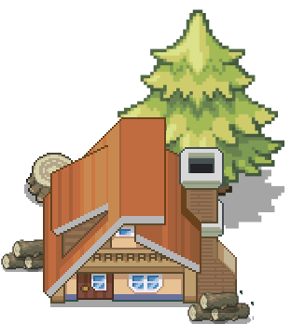

Enroll villagers
Collect resources
Build to help you collect
Fight for survival
Manage your buildings
9

Slide 12
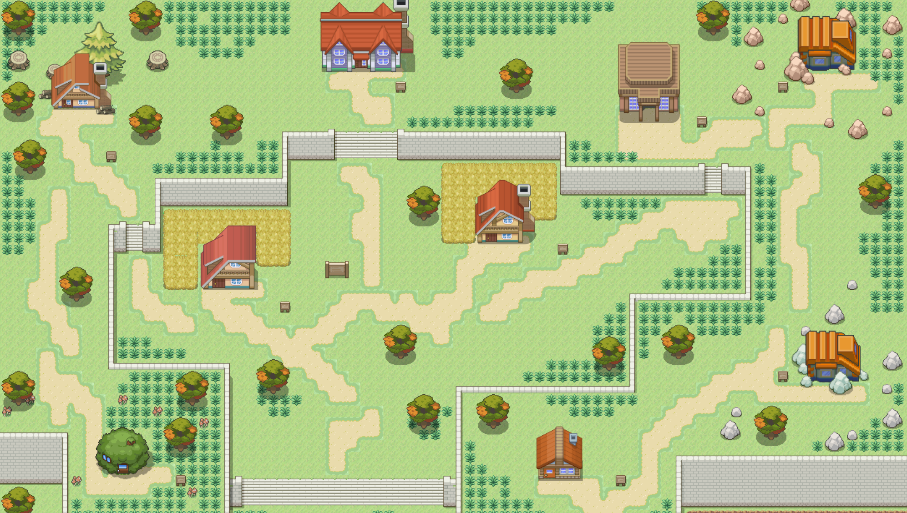


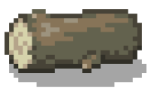

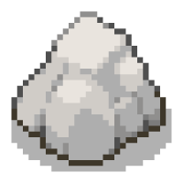



Build your own village
Build your own village

Slide 13

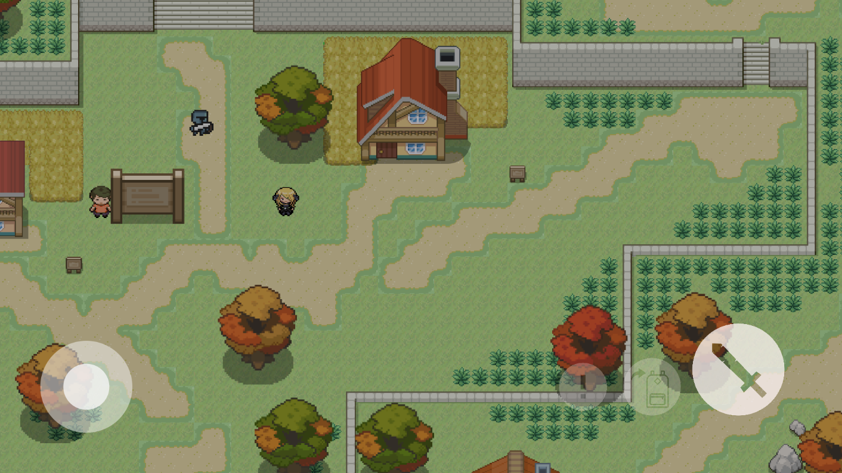
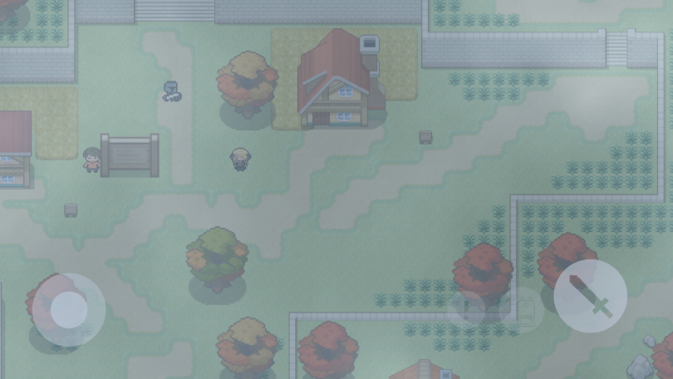
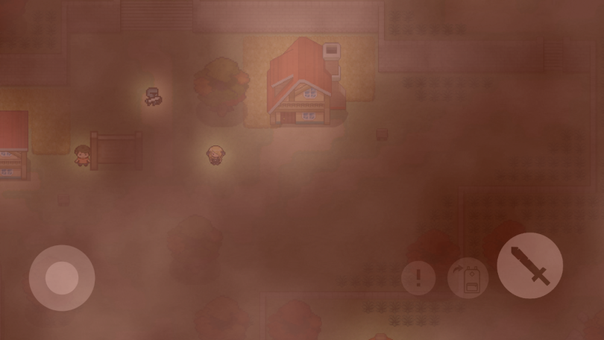
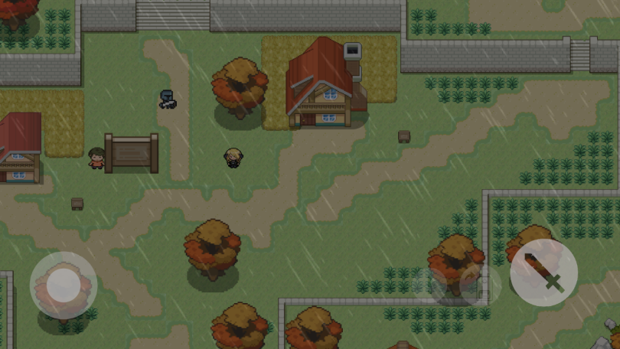
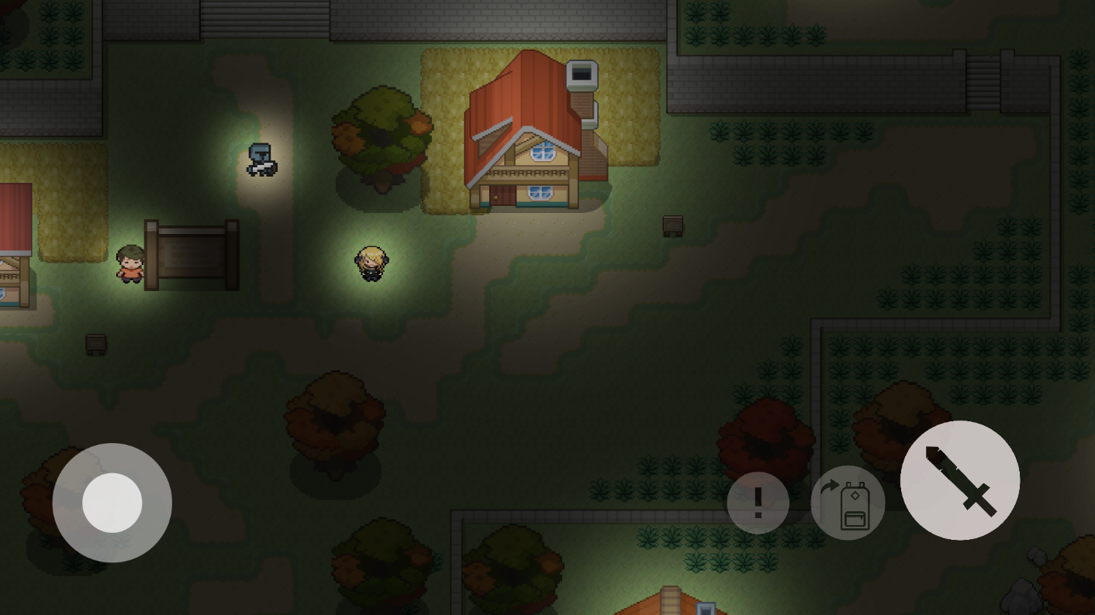
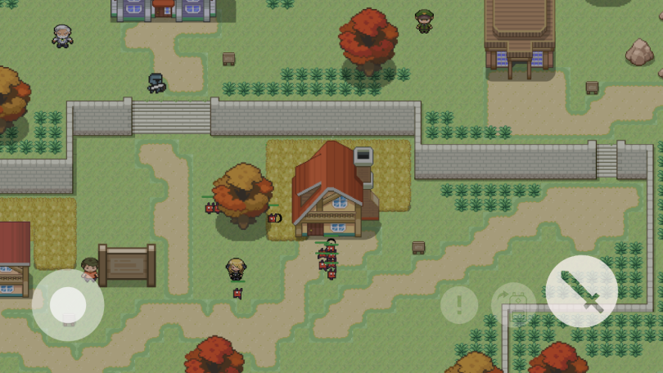
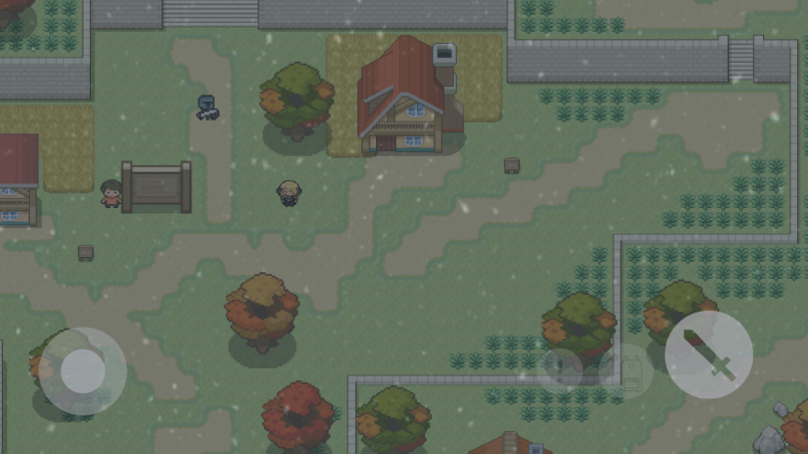
Survive to events
Day & Night Cycle
Weather Cycle
Random Events
11

Slide 14




Interact outside the game
BOOMCRAFT
become an alchemist
takes part in the war economy
ruin yourself to be the best
sign in with facebook
share your progress
12

Slide 15
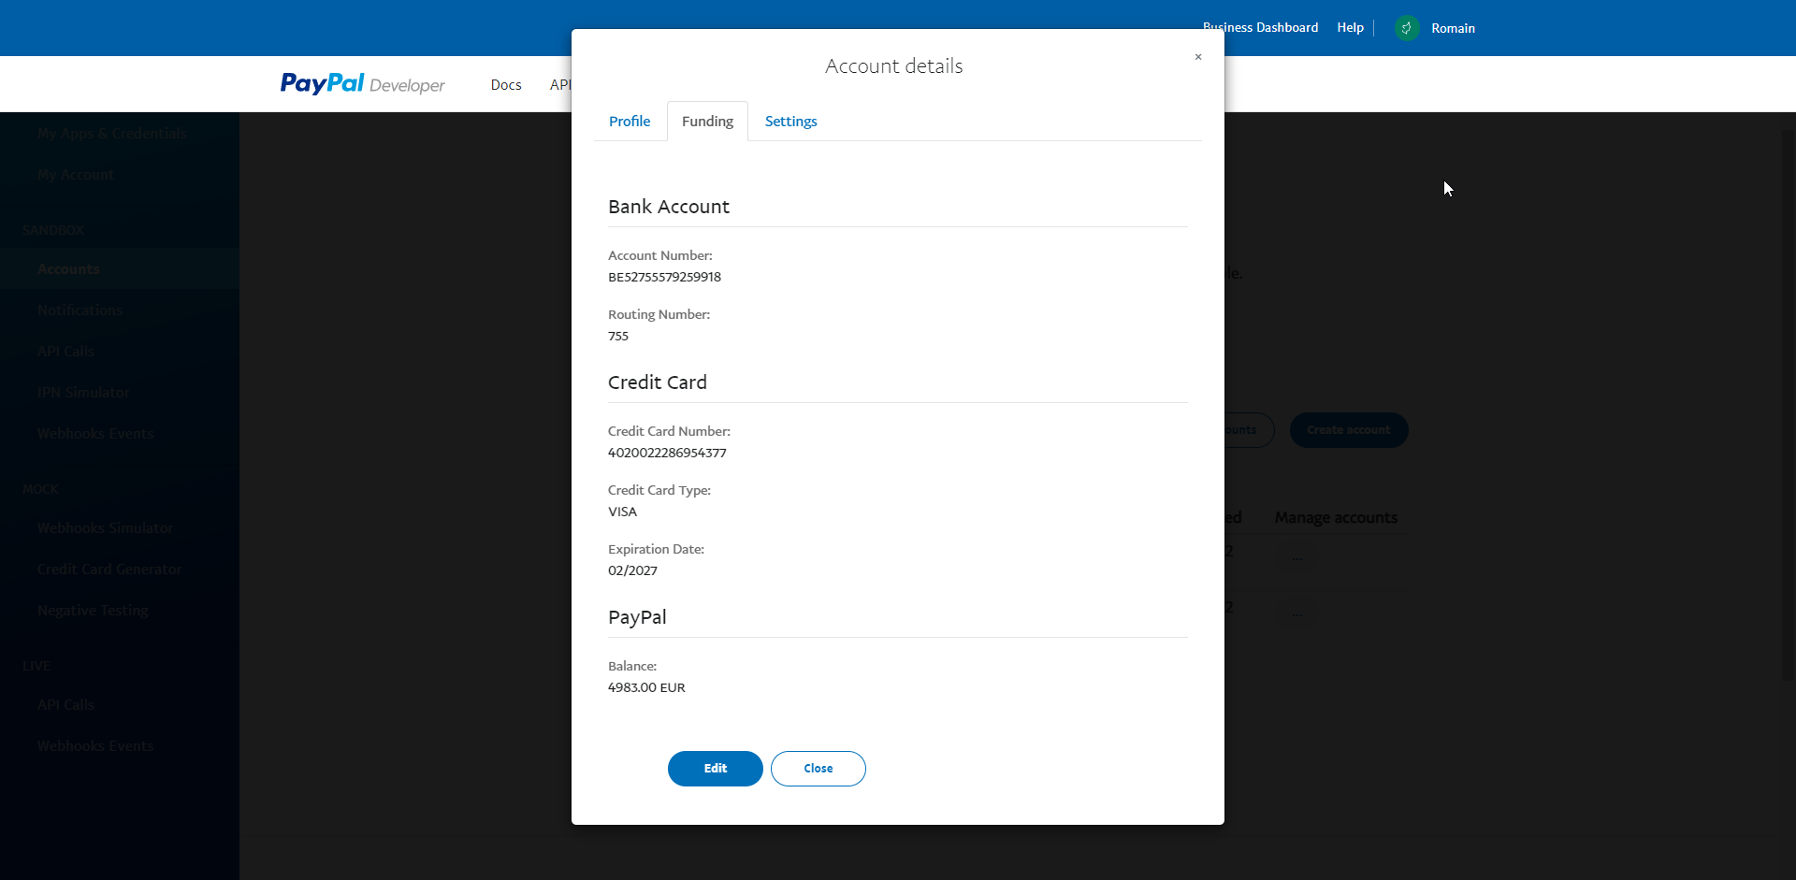
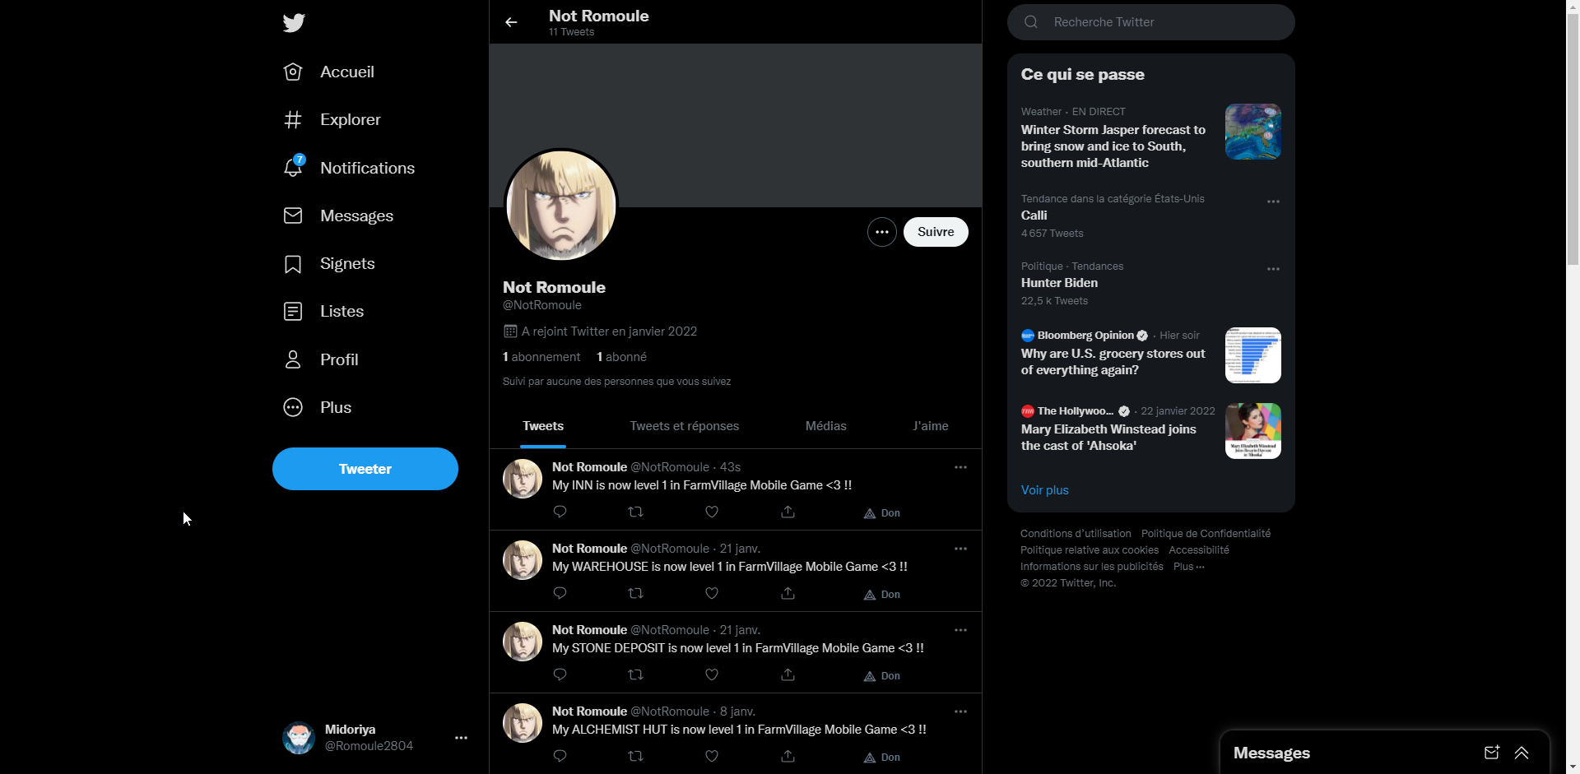
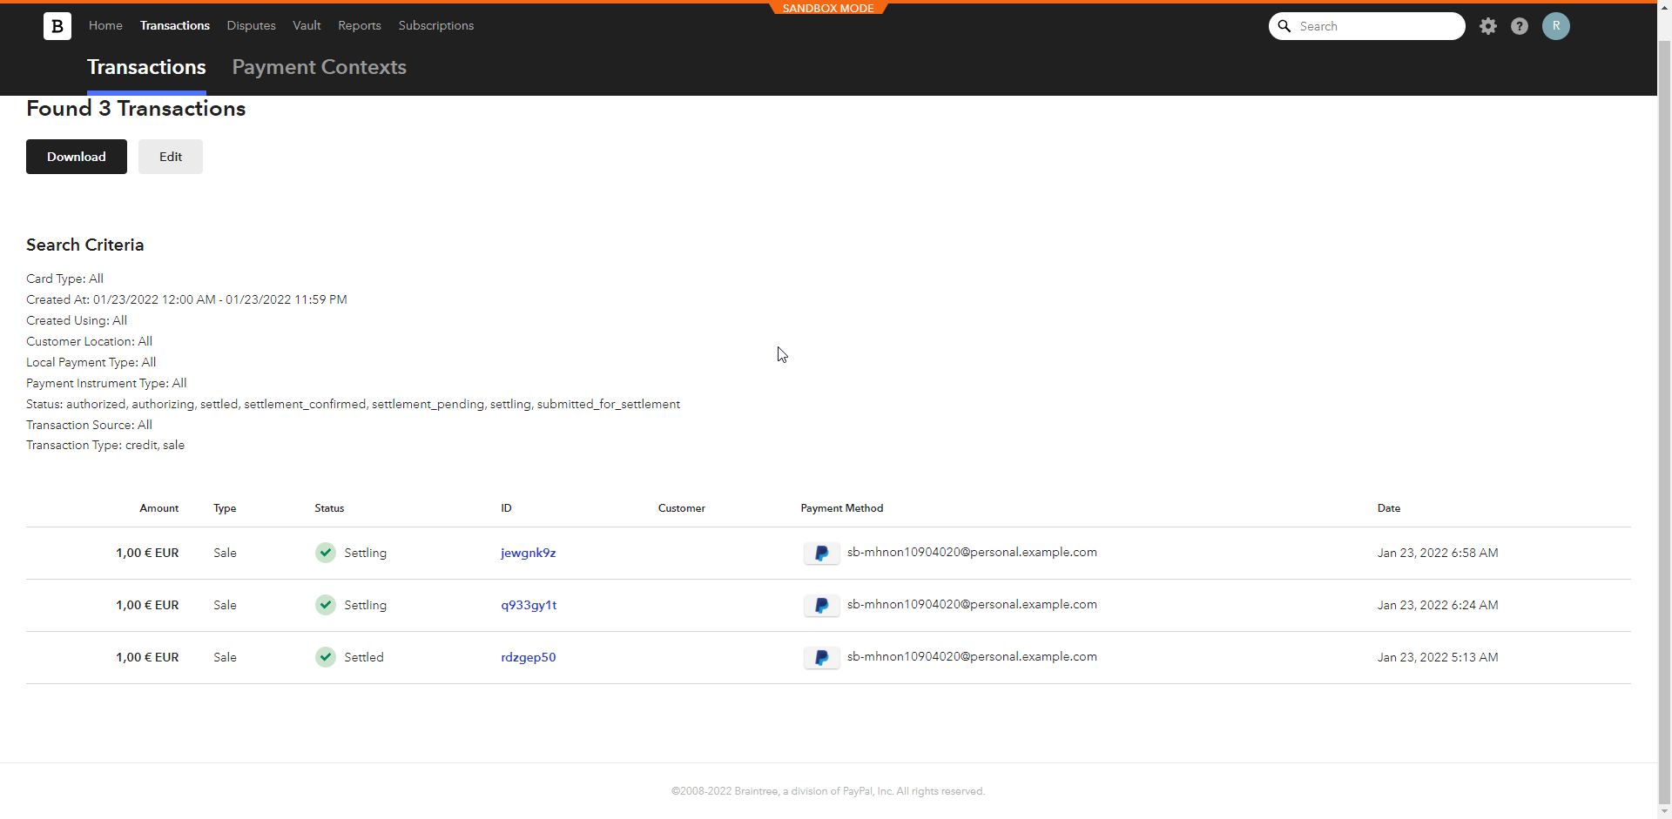
Spend your money and prove to others that you are the best
13

Slide 16

14

Slide 17

Invite your friends
15

Slide 18


Enjoy the game
Presented by Mercenier Louis, Martinot Romain & Streignard Rémi

